Slide 1

The Nature of Organizational Design
What is organizational design?
  The overall set of structural elements and relationships among those elements used to manage the total organization.
Organization design can be traced back to two universal perspectives:
  Bureaucratic model.
  Behavioral model.
And
Situational (Contingency) Perspective

Slide 2
Bureaucracy: Based on a Legitimate and Formal System of Authority
The organization should adopt a distinct division of labor.
Develop a consistent set of rules.
Establish a hierarchy of positions.
Managers should conduct business impersonally to maintain social distance.
Employment and promotion should be based on technical expertise, and employees should be protected from arbitrary dismissal.

Slide 3
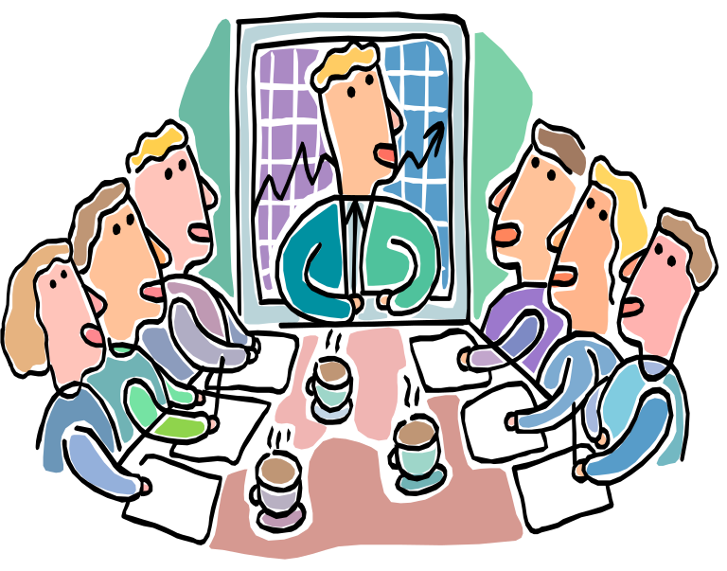
Behavioral Model
A model of organization design consistent with the human relations movement and stressing attention to developing work groups and concern about interpersonal process.

Slide 4
System 1 Design
Leadership process includes no perceived confidence and trust.
Motivational process taps only physical, security, and economic motives.
Communication process is such that information flows downward.
Interaction process is closed.
Decisions occur at the top.
Goal setting occurs at top.
Control is centralized.
Performance goals are low.
System 4 Organization
Leadership process includes perceived confidence and trust.
Motivational process taps a full range of motives through participatory methods.
Communication flows freely.
Interaction process is open.
Decisions occur at all levels.
Goal setting encourages group participation.
Control process is dispersed.
Performance goals are high.

Slide 5
Situational Influences on
Organizational Design
What is it?
Optimal design depends on a set of relevant situational factors.
Situational factors play a role in determining the best organization design for any particular circumstance.
There are four basic situational factors.

Slide 6
The Basic Situational Factors
Technology:
  Conversion processes used to transform inputs into outputs.
Environment:
  Organizations in stable environments tend to have different kind of design from organizations in unstable environments.
Organizational size
  The total number of full-time or full-time equivalent employees.
organizational life cycle
  Progression through which organizations evolve as they grow and mature.
What are the life cycle stages? Birth  Youth  Midlife  Maturity.
What is corporate level strategy?
Organizations can adopt a variety of corporate level strategies, such as:
  Single-product strategy.
  Portfolio approach.
The chosen strategy affects the organizational design.

Slide 7
Two Designs Emerged from Stable and Unstable Environments
  Mechanistic organization:
    Similar to the bureaucratic or system 1 model; most frequently found in stable environments.
  Organic organization:
    Very flexible and informal model of organization design; most often found in unstable and unpredictable environments.

Slide 8
Organizations Characterized by
Two Primary Factors:
Differentiation:
  The extent to which the organization is broken down into subunits.
Integration:
  The degree to which the various subunits must work together in a coordinated fashion.

Slide 9
Business Level Strategy
These strategies can affect the design of individual businesses within the organization as well the overall organization itself.
What are the possible outcomes?
  An organization can be centralized or decentralized.

Slide 10
Organizational Functions
Aggressive marketing strategy calls for separate departments such as advertising, direct sales, and sales promotion.
A production strategy can call for manufacturing in diverse locations.
Human resource strategy may call for a lesser degree of decentralization.

Slide 11
Why Are There Different Types of Organizations?
Depending on what the product or service is, the management has to structure the organization to met the customer’s needs.

Slide 12
Basic Forms of Organizational Design
U-Form or Functional design:
  An organizational arrangement based on the functional approach to departmentalization.
H-Form or Conglomerate design: Birth  Youth  Midlife  Maturity.
  An arrangement used by an organization made up of a set of unrelated businesses.
  Birth  Youth  Midlife  Maturity.

Slide 13
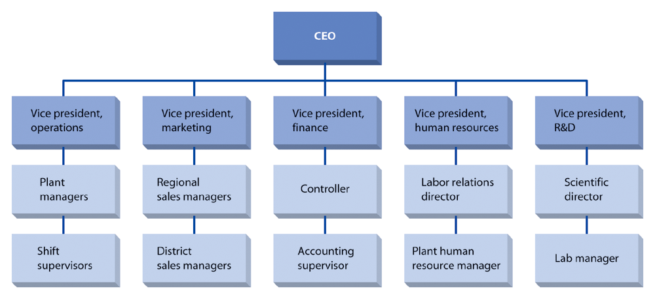
Functional or U-Form Design for a Small Manufacturing Company

Slide 14
M-Form or Divisional Design
An organizational arrangement based on multiple businesses in related areas operating within a larger organizational framework.
Matrix design: (see Figure 12.4)
  An organizational design based on two overlapping bases of departmentalization.
Hybrid design:
  The use of two or more common forms of organizational design.

Slide 15
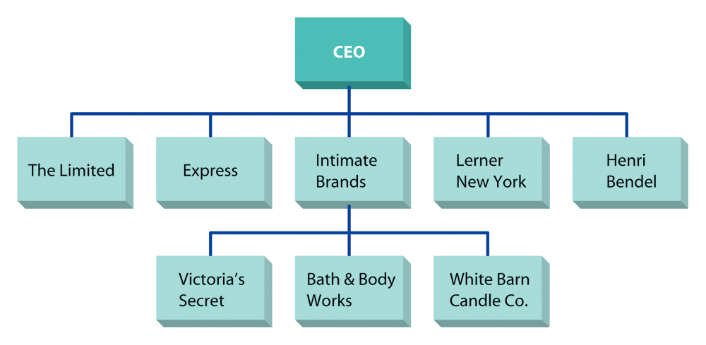
Multidivisional (M-Form) Design at The Limited, Inc.

Slide 16
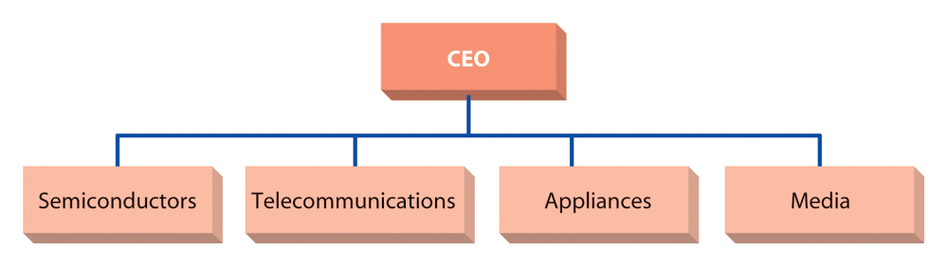
Conglomerate (H-Form) Design at Pearson PLC

Slide 17
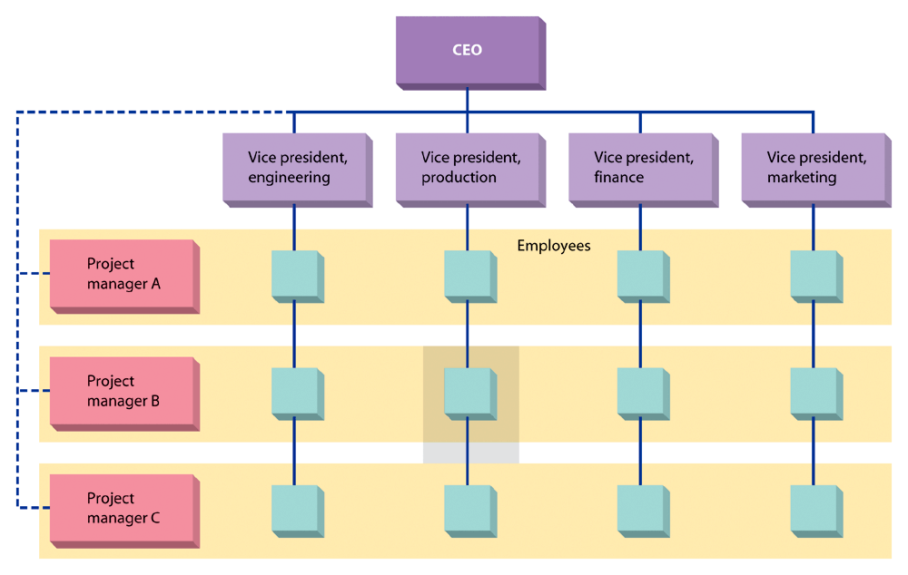
A Matrix Organization

Slide 18
Emerging Issues in Organizational Design
Team organization:
  Relies almost exclusively on product type teams, with little or no underlying functional hierarchy.
Virtual organization:
  Has little or no formal structure.
Learning organization:
  Works to facilitate the lifelong learning and personal development of all its employees while transforming itself to respond to changes and demands.
International Organizational Design
International markets create an organization design that fits unique circumstances:
  Separate international divisions.
  Extension of product departmentalization.
  Extension of the multidivisional structure.

